Slide 1
Struts

Slide 2
Outline
Struts: Overview,
architecture, configuration, actions, interceptors, result types, validations, localization,
exception handling, annotations.

Slide 3
Struts Overview
Apache Struts 2 is an elegant, extensible framework for creating enterprise-ready Java web applications.
This framework is designed to streamline the full development cycle from building to deploying and maintaining applications over time.
Struts 2 Features:
1) Configurable MVC components:
Struts 2 framework provides all the components information (view components and action classes) in struts.xml file. If we need to change any information, we can simply change it in this xml file.
2) POJO based actions:
In struts 2, action class is POJO (Plain Old Java Object) i.e. a simple java class. Here, we are not forced to implement any interface or inherit any class.

Slide 4
Struts Overview :Features
3) AJAX support
Struts 2 provides support to ajax technology. It is used to make asynchronous request i.e. it doesn't block the user. It sends only required field data to the server side not all. So it makes the performance fast.
4) Integration Support
We can simply integrate the struts 2 application with hibernate, spring, etc. frameworks.
5) Various Result Types
We can use JSP, freemarker, velocity etc. technologies as the result in struts 2.
6) Various Tag support
Struts 2 provides various types of tags such as UI tags, Data tags, control tags, etc. to ease the development of struts 2 application.
7) Theme and Template support
Themes and templates can be used for common look and feel. Struts 2 provides three types of theme support: simple, xhtml and css_xhtml. The xhtml is default theme of struts 2.

Slide 5
Outline
Struts: Overview,
architecture, configuration, actions, interceptors, result types, validations, localization,
exception handling, annotations.

Slide 6
Struts Architecture
The struts 2 framework is used to develop MVC-based web application.
The Struts framework provides the configurable MVC support.
The Model-View-Controller pattern in Struts2 is implemented with the following five core components −
Actions
Interceptors
Value Stack / OGNL
Results / Result types
View technologies

Slide 7
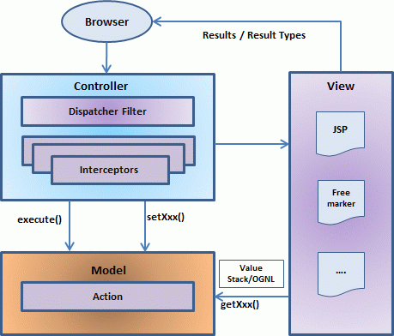
Struts Architecture

Slide 8
Struts Architecture
User’s Request Life Cycle:
User sends a request to the server, requesting for some resource (i.e. pages).
The Dispatcher Filter looks at the request and then determines
the appropriate Action.
Configured interceptor applies functionalities such as validation, file upload etc.
Selected action is performed based on the requested operation.
Again, configured interceptors are applied to do any post-
processing if required.
Finally, the result is prepared by the view and returns the result to the user.

Slide 9
Struts 2 - Hello World Example
Create Following Four Components For Any Struts 2 Project
SN. | Components & Description
1 | Action Create an action class which will contain complete business logic and control the interaction between the user, the model and the view.
2 | Interceptors Create interceptors if required or use existing interceptors. This is part of Controller.
3 | View Create JSPs to interact with the user to take input and to present the final messages.
4 | Configuration Files Create configuration files to couple the Action, View and Controllers. These files are struts.xml, web.xml, struts.properties.

Slide 10
Struts 2 - Hello World Example
In Eclipse File > New > Dynamic Web Project and enter project name as HelloWorldStruts2
Select all the default options in the next screens and finally check
Generate Web.xml deployment descriptor option.
Copy following Strut 2 jar files in the lib folder of your project.
commons-fileupload-x.y.z.jar
commons-io-x.y.z.jar
commons-lang-x.y.jar
commons-logging-x.y.z.jar
commons-logging-api-x.y.jar
freemarker-x.y.z.jar
javassist-.xy.z.GA
ognl-x.y.z.jar
struts2-core-x.y.z.jar
xwork-core.x.y.z.jar

Slide 11
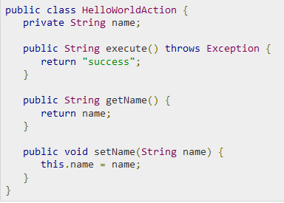
Struts 2 - Hello World Example
4. Create Action Class- create a java file HelloWorldAction.java under Java Resources > src within a package name com.struts2 with the contents given below:

Slide 12
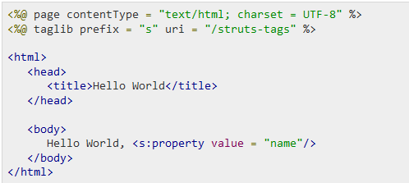
Struts 2 - Hello World Example
5. Create a View- create the below jsp file HelloWorld.jsp in the WebContent folder in your struts2 project.

Slide 13
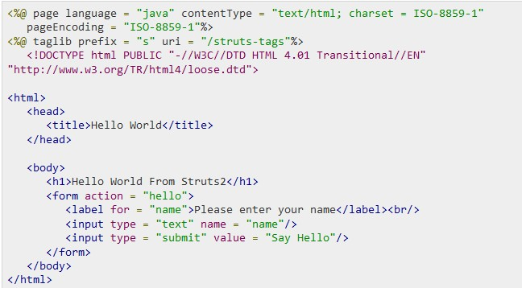
Struts 2 - Hello World Example
6. Create Main Page- We also need to create index.jsp in the WebContent folder. This file will serve as the initial action URL where a user can click to tell the Struts 2 framework to call a defined method of the HelloWorldAction class and render the HelloWorld.jsp view.

Slide 14
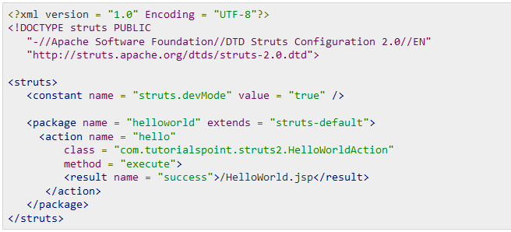
Struts 2 - Hello World Example
7. Configuration Files- We need a mapping to tie the URL, the HelloWorldAction class (Model) and the HelloWorld.jsp (View) together. Hence, create struts.xml file under the WebContent/WEB-INF/classes folder.

Slide 15
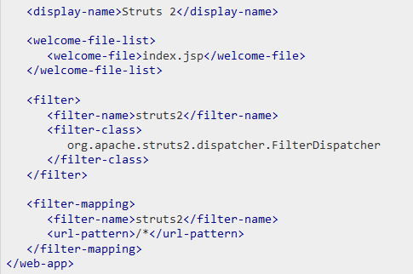
Struts 2 - Hello World Example
Next step is to create a web.xml file which is an entry point for any request to Struts 2. The entry point of Struts2 application will be a filter defined in deployment descriptor (web.xml). Hence, we will define an entry of org.apache.struts2.dispatcher.FilterDispatcher class in web.xml.

Slide 16

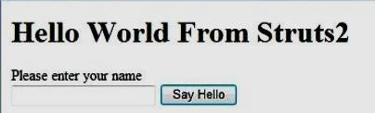


Struts 2 - Hello World Example
Procedure for Executing the Application:
Right click on the project name and click Export > WAR File to create a War file.
Then deploy this WAR in the Tomcat's webapps directory.
Finally, start Tomcat server and try to access URL http://localhost:8080/HelloWorldStruts2/index.jsp. This will give you following screen −
If we enter a value "Struts2" and submit the page. You should see the next page

Slide 17
Outline
Struts: Overview,
architecture, configuration, actions, interceptors, result types, validations, localization,
exception handling, annotations.

Slide 18
Struts Configuration
Basic configuration files which is required for a Struts 2 application:
web.xml,
struts.xml,
struts-config.xml,
struts.properties

Slide 19
Struts Configuration
The web.xml File
The web.xml configuration file is a J2EE configuration file that determines how elements of the HTTP request are processed by the servlet container.
This file provides an entry point for any web application by specifying index.jsp/index.html
The web.xml file needs to be created under the folder
WebContent/WEB-INF.

Slide 20
Struts Configuration
The Struts.xml File
The struts.xml file contains the configuration information that you will be modifying as actions are developed.
This file can be used to override default settings for a Struts application.
This file can be created under the folder WEB-INF/classes.
The first thing to note is the DOCTYPE.
<struts> is the root tag element, under which we declare
different packages using <package> tags.

Slide 21
Struts Configuration
The Struts-config.xml File
The struts-config.xml configuration file is a link between the View and Model components.
The configuration file basically contains following main elements −
struts-config- This is the root node of the configuration file.
form-beans-This is where you map your ActionForm subclass to a name.
action-mappings-This is where you declare form handlers
Controller-This section configures Struts internals
plug-in-This section tells Struts where to find your properties files, which contain prompts and error messages

Slide 22
Struts Configuration
The Struts.properties File
This file provides a mechanism to change the default behavior of the framework.
We can create this file under the folder WEB-INF/classes.
The values configured in this file will override the default values configured in default.properties which is contained in the struts2-core-x.y.z.jar

Slide 23
Outline
Struts: Overview,
architecture, configuration, actions, interceptors, result types, validations, localization,
exception handling, annotations.

Slide 24
Struts 2 - Actions
Action classes are the core of the Struts2 framework.
Each URL is mapped to a specific action which will provide the processing logic which is necessary to service the request from the user.
The action class plays an important role in the transfer of data from the request to the view, whether its a JSP or other type of result.
The action must assist the framework in determining which result should render the view that will be returned in the response to the user request.

Slide 25
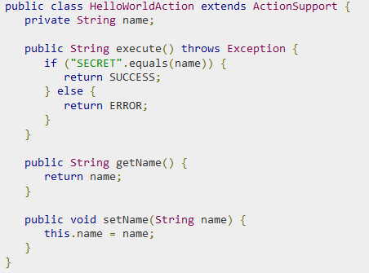
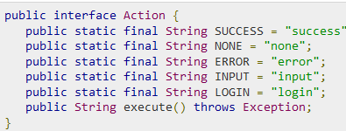
Struts 2 - Actions
Create Action:
The only requirement for actions in Struts2 is that there must be a method with no-argument .
If the no-argument method is not specified, the default is to use the execute() method.
Action class can extend the ActionSupport class which implements six interfaces including Action interface.
The Action interface is as follows −
Action class in the Hello World example:

Slide 26
Outline
Struts: Overview,
architecture, configuration, actions, interceptors, result types, validations, localization,
exception handling, annotations.

Slide 27
Struts 2 - Interceptors
Interceptors allow for cross cutting functionality to be implemented separately from the action as well as the framework. You can achieve the following using interceptors −
Providing preprocessing logic before the action is called.
Providing postprocessing logic after the action is called.
Catching exceptions so that alternate processing can be performed.
Many of the features provided in the Struts2 framework are implemented using interceptors.
Examples include exception handling, file uploading, lifecycle callbacks, etc.

Slide 28
Struts 2 - Interceptors
Few of the important interceptors are listed below −
Interceptors & Description
Alias-Allows parameters to have different name aliases across requests.
Checkbox- Assists in managing check boxes by adding a parameter value of false for check boxes that are not checked.
i18n-Keeps track of the selected locale during a user's session.
Exception- Maps exceptions that are thrown from an action to a result, allowing automatic exception handling via redirection.
fileUpload- Facilitates easy file uploading.
Params- Sets the request parameters on the action.
Prepare- This is typically used to do pre-processing work, such as setup database connections.
Timer- Provides simple profiling information in the form of how long the action takes to
execute.
Token-Checks the action for a valid token to prevent duplicate formsubmission.
Validation-Provides validation support for actions

Slide 29

Struts 2 - Interceptors
Create Interceptors:
We will use the timer interceptor whose purpose is to measure how long it took to execute an action method.
Also, using params interceptor we can send the request parameters to the action.
modify the struts.xml file to add an interceptor

Slide 30
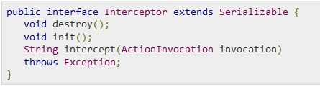
Struts 2 - Interceptors
Create Custom Interceptors
Using custom interceptors in your application is an elegant way to provide cross-cutting application features.
init() method provides a way to initialize the interceptor and the destroy() method provides a facility for interceptor cleanup.
The ActionInvocation object provides access to the runtime environment.

Slide 31
Outline
Struts: Overview,
architecture, configuration, actions, interceptors, result types, validations, localization,
exception handling, annotations.

Slide 32
Struts 2 - Results & Result Types
The action is responsible for executing the business logic.
The next step after executing the business logic is to display the view using the <results> tag.
<results> tag plays the role of a view in the Struts2 MVC framework.
For example, if the action method is to authenticate a user, there are three possible outcomes.
Successful Login
Unsuccessful Login - Incorrect username or password
Account Locked

Slide 34
Struts 2 - Result Types
1. The Dispatcher Result Type:
The dispatcher result type is the default type and is used if no other result type is specified. It's used to forward to a servlet, JSP, HTML page and so on, on the server. It uses the RequestDispatcher.forward() method.
<result name = "success" type = "dispatcher">
/HelloWorld.jsp
</result>
2. The FreeMaker Result Type:
Freemaker is a popular template engine that is used to generate output using predefined templates.
Following creates a Freemaker template file called hello.fm with the following contents −
Hello World ${name}
In the above file, name is a parameter which will be passed from outside using the defined action.

Slide 35
Struts 2 - Result Types
3. The Redirect Result Type:
The redirect result type calls the standard response.sendRedirect() method, causing the browser to create a new request to the given location.
We can provide the target location either in the body of the
<result> element or in a <param name = "location"> element.
<result name = "success" type = "redirect">
<param name = "location">
/NewWorld.jsp
</param >
</result>

Slide 36
Outline
Struts: Overview,
architecture, configuration, actions, interceptors, result types, validations, localization,
exception handling, annotations.

Slide 37
Struts 2 - Validations Framework
The validation framework assists the application to run the rules in order to perform validation before the action method is executed.
We will take an example of an EmployeeAction class and we will put validation to make sure that the user always enters an age in a range between 28 and 65.

Slide 38
Struts 2 - Validations Framework
Create Main Page- JSP file index.jsp, which will be used to collect Employee related information:
<%@ page language = "java" contentType = "text/html; %>
<%@ taglib prefix = "s" uri = "/struts-tags"%>
<html>
<body>
<s:form action = "empinfo" method = "post">
<s:textfield name = "age" label = "Age" size = "20" />
<s:submit name = "submit" label = "Submit" align="center" />
</s:form>
</body>
</html>

Slide 39
Struts 2 - Validations Framework
Create Views- We will use JSP file success.jsp which will be invoked in case the defined action returns SUCCESS.
<%@ page language = "java" contentType = "text/html; "%>
<%@ taglib prefix = "s" uri = "/struts-tags"%>
<html>
<body>
Employee Information is captured successfully.
</body>
</html>

Slide 40
Struts 2 - Validations Framework
Create Action- action class EmployeeAction with a method called validate() in Employee.java file.
public class EmployeeAction extends ActionSupport {
private int age;
public String execute() {return SUCCESS; }
public int getAge() { return age; }
public void setAge(int age) { this.age = age; }
public void validate() {
if (age < 28 || age > 65)
addFieldError("age","Age must be in between 28 and 65");
}
}

Slide 41
Struts 2 - Validations Framework
Configuration Files
Finally, let us put everything together using the struts.xml
configuration file as follows −
<?xml version = "1.0" Encoding = "UTF-8"?>
<!DOCTYPE struts PUBLIC ……>
<struts>
<constant name = "struts.devMode" value = "true" />
<package name = "helloworld" extends = "struts-default">
<action name = "empinfo"
class = "com.struts2.EmployeeAction"
method = "execute">
<result name = "input">/index.jsp</result>
<result name = "success">/success.jsp</result>
</action>
</package>
</struts>

Slide 42
Outline
Struts: Overview,
architecture, configuration, actions, interceptors, result types, validations, localization,
exception handling, annotations.

Slide 43
Struts2 - Localization
Internationalization (i18n) is the process of planning and implementing products and services so that they can be easily adapted to specific local languages and cultures.
The internationalization process is called translation or localization enablement.
Internationalization is abbreviated i18n because the word starts with the letter “i” and ends with “n”, and there are 18 characters between the first i and the last n.
Struts2 provides localization i.e., internationalization (i18n) support through resource bundles.

Slide 44
Struts2 – Localization- Resource Bundles
Struts2 uses resource bundles to provide multiple language and locale options to the users of the web application.
We can create a resource bundle for each language that we want.
The resource bundles will contain titles, messages, and other text in the language of your user.
Resource bundles are the files that contains the key-value pairs for the default language of your application.
The simplest naming format for a resource file is −
bundlename_language_country.properties
Here, bundlename could be ActionClass, Interface, SuperClass, Model, Package, Global resource properties.
The next part, language_country represents the country locale for example,
English (United States) locale is represented by en_US, etc.

Slide 45
Struts2 – Localization
To develop your application in multiple languages, you should maintain multiple property files corresponding to those languages/locale and define all the content in terms of key-value pairs.
For example, if you are going to develop your application for US English (Default), Spanish, and French, then you would have to create three properties files.
global.properties − By default English (United States) will be applied
global_fr.properties − This will be used for French locale.
global_es.properties − This will be used for Spanish locale.

Slide 46


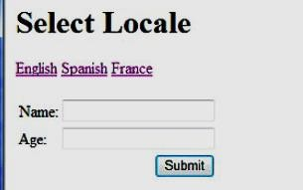

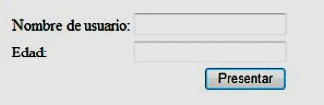
Struts2 – Localization Example
Now select any of the languages, let us say we select Spanish, it would display the following result −

Slide 47
Outline
Struts: Overview,
architecture, configuration, actions, interceptors, result types, validations, localization,
exception handling,
annotations.

Slide 48
Struts 2 - Exception Handling
Struts provides an easier way to handle uncaught exception through "exception" interceptor and redirect users to a dedicated error page.
We can easily configure Struts to have different error pages for different exceptions.
Create a file called Error.jsp
<html>
<body>
This is my custom error page
</body>
</html>
Modify the struts.xml by adding following line−
<result name = "error"> /Error.jsp </result>

Slide 49
Outline
Struts: Overview,
architecture, configuration, actions, interceptors, result types, validations, localization,
exception handling,
annotations.

Slide 50
Struts 2 - Annotations
Struts provides two forms of configuration:
to use the struts.xml file for all the configurations.
by using the Java 5 Annotations feature.
To start using annotations in your project, make sure you have included the following jar files in your WebContent/WEB-INF/lib folder −
struts2-convention-plugin-x.y.z.jar
asm-x.y.jar
antlr-x.y.z.jar
commons-fileupload-x.y.z.jar
commons-io-x.y.z.jar
commons-lang-x.y.jar
commons-logging-x.y.z.jar
commons-logging-api-x.y.jar
freemarker-x.y.z.jar
javassist-.xy.z.GA
ognl-x.y.z.jar
struts2-core-x.y.z.jar
xwork-core.x.y.z.jar

Slide 51
Struts 2 – Annotations Example
Validation on Age as range between 28 and 65.
import org.apache.struts2.convention.annotation.Action;
import org.apache.struts2.convention.annotation.Result;
import org.apache.struts2.convention.annotation.Results;
import com.opensymphony.xwork2.validator.annotations.*;
public class Employee extend ActionSupport {
private int age;
public int getAge() { return age; }
public void setAge(int age) { this.age = age; }
@IntRangeFieldValidator(message = "Age must be in between 28 and 65", min = "28", max = "65")
}

Slide 52
Struts 2 – Annotations Types
Annotations Types
Namespace Annotation (Action Annotation)
Result Annotation - (Action Annotation)
Results Annotation - (Action Annotation) The @Results annotation defines a set of results for an Action.
After Annotation - (Interceptor Annotation) The @After annotation marks a action method that needs to be called after the main action method and the result was executed. Return value is ignored.
Before Annotation - (Interceptor Annotation) The @Before annotation marks a action method that needs to be called before the main action method and the result was executed. Return value is ignored.
EmailValidator Annotation - (Validation Annotation)
IntRangeFieldValidator Annotation - (Validation Annotation)
RequiredFieldValidator Annotation - (Validation Annotation)

